Slide 1
Forex Market forecasting using recurrent neural nets (LSTM/GRU)
Data Set: Forex data collected from https://www.forexfactory.com/
Python, BeautifulSoup, Tensorflow - Keras

Slide 2
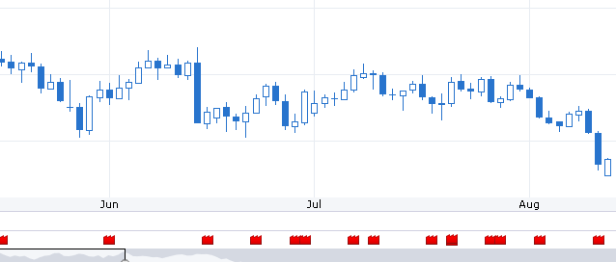
Abstract
There are several websites which provide historic data on Forex / stocks etc. In principle historic data for a time series can be used to predict its future trends. The value of a time series data is also affected due to various external factors, In our case lets say the currency value is affected by various parameter like economic/policy decisions, regulations etc. There can be several sources of such information like government websites, twitter, websites providing financial news etc.
Forex factory is such a web site that provides data for various currencies along with the financial news item associated over the time (series). Following pic shows EUR/USD price and on the X axis we see some Red/Yellow marks indicating financial news item of varied importance.
These news items are important predictors for the currency value. By combining these along with the historical currency value we can build a better forecasting model.

Slide 3
Data collection & Cleansing
Python provides a useful mechanism to collect data from websites using a library called BeautifulSoup. This mechanism is called web scrapping.
I built a web scrapper and collected AUD/USD data for 10 years along with news of High and medium importance.
After getting the data it was cleansed programmatically to take care of following issues:
Null data
Date Time conversion
Removal of non-ascii characters
So the data was ready to be used as input of ML algorithms.

Slide 4
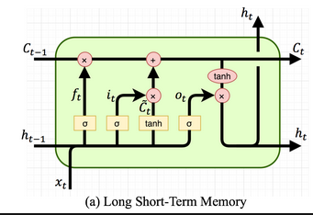
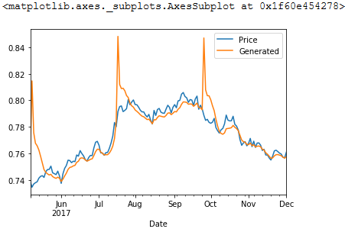
Model 1 – RNN based on LSTM
First Model was based on LSTM (Long Short Term Memory) cell and a model of 100 LSTM units was chosen. Below diagram shows a basic LSTM cells architecture:
The model performance on training data is shown as:

Slide 5
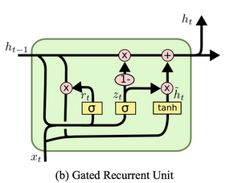
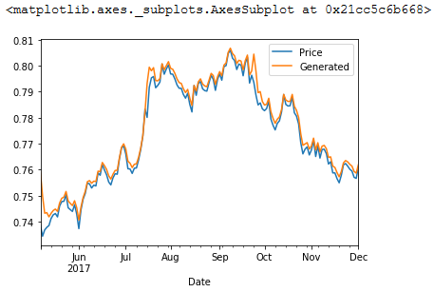
Model 2 – RNN based on GRU
Gated Recurrent Unit is a modified version of LSTM, Its easier to train due to its simplicity over LSTM. For second Model 100 GRU units was chosen. Below diagram shows a basic GRU unit architecture:
The model performance on training data is shown as:

Slide 6
Conclusion
The overall performance of GRU unit was better as compared to LSTM on training data. This model provides a base for time series prediction model. The currency value may depends on various aspects other than financial news covered by the portal. In future work more predictors could be used and more advanced recurrent neural networks could be used for better prediction accuracy.

